Slide 1

Inheritance and Virtual methods
Lecturer
Rokas Slaboševičius
Data

Slide 2
Today you will learn
Inheritance and Virtual methods
Inheritance
01
Virtual Methods
02

Slide 3



Inheritance
Inheritance and Virtual methods
Inheritance is an important feature of the object-oriented programming paradigm, allowing hierarchies to be created and properties and actions to be shared between classes
Inheritance is one of the "Pillars of OOP"
Inheritance can potentially help to reduce duplicated code and create class descriptions closer to real life

Slide 4
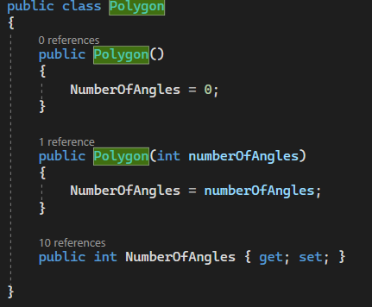
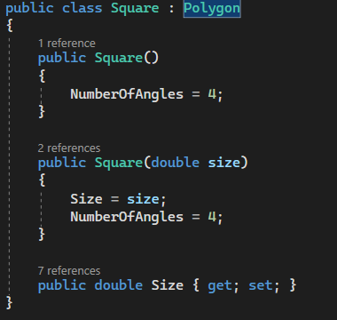
Inheritance
Inheritance and Virtual methods
Inheritance allows the creation of hierarchies in which one class inherits properties and actions from another class.
The parent class (Polygon) is a higher-level class that defines common logic and properties, while child classes (Square) are lower-level classes that inherit the properties of the parent class and may additionally have their own properties and actions.
For example, we can have a parent class "Animal" with the properties "name" and "age", and a child class "Dog" or "Cat", which inherit the properties of the parent class and may have additional specific properties such as "breed"

Slide 5
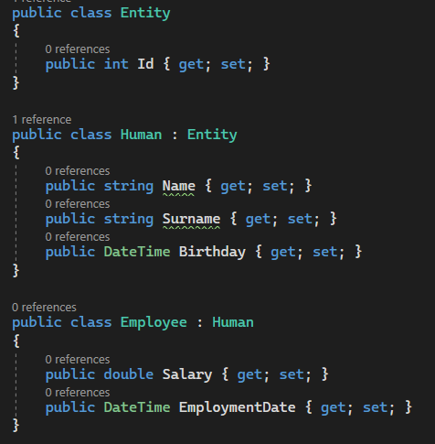
Inheritance
Inheritance and Virtual methods
Inheritance supports as many levels as our class descriptors may need.
It is recommended not to do very deep inheritance, as the class structure and traceability of the code make code maintenance very difficult.

Slide 6

Inheritance and Virtual methods
Task 1
Create a base class "Vehicle" with the property "Speed". Write a child class "Car" that inherits the "Vehicle" class. Create an object from the "Car" class and set the speed. Print the speed of the Car. Extend the program by creating a "Bike" class and do the same as you did with the "Car" class.
Create a base class Employee with the properties Name and Salary. Write a child class "Manager" that inherits the "Employee" class. Add the property "Employees" and set its value. Print the name of the manager, the salary and the number of employees belonging to the manager.
Extend the Employee class from the previous exercise by creating a child class Programmer that inherits the Employee class. Add the property "ProgrammingLanguage" and set its value. Print the programmer's name, salary and programming language. Create a "Manager" method that prints out all the information about the programmers in his team.

Slide 7
Inheritance and Virtual methods
Task 2
Create a base class "Product" with properties "Name" and "Price". Write a child class "Food" that inherits the "Product" class. Add the property "ExpirationTime" and set its value. Print the name, price and expiry time of the food.
Expand the Product class from the previous exercise by creating a child class called Electronic that inherits the Product class. Add the property "Warranty" and set its value. Print the name of the electronics, the price and the warranty period.
Describe the vehicle rental system. Your system should have classes of customers, classes of vehicles, classes of different payment methods. Create a short scenario where you as a customer can reserve the vehicle you want and depending on the vehicle it should throw a message when the methods "Drive()", "PrintMaxSpeed", "GetCapacity" and "GetFuelEfficiency" are used.

Slide 8
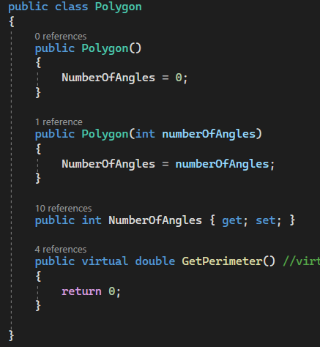
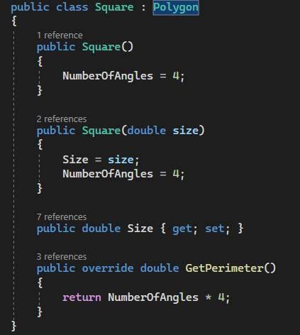
Virtual methods
Inheritance and Virtual methods
Virtual methods are an important aspect of the object-oriented programming paradigm, allowing a method to be rewritten in a child class that inherits the method of the parent class.
This allows you to modify the behaviour of the methods and adapt them to the specific needs of your child's class.
Virtual methods are defined in the parent class with the keyword "virtual" and can be overridden in the child class with the keyword "override".
This allows you to dynamically select the appropriate version of a method based on the type of object that is stored in the parent class pointer.

Slide 9
Inheritance and Virtual methods
Task 3
Create a base class called "Transport" with the virtual method "MeasureSpeed()". Implement this method by returning a standard speed measurement result. Create an object from the Transport class and call the MeasureSpeed() method. Extend the "Transport" class from the previous exercise by creating an inherited class called "Car" which overrides the virtual method "MeasureSpeed()". Implement this method by returning the result of measuring the speed of the car. Create an object from the "Car" class and call the "MeasureSpeed()" method.
Create a base class called "Employee" with the virtual method "Greeting()". Implement this method by returning a standard greeting message. Create an object from the "Employee" class and call the "Greeting()" method.
Extend the Employee class from the previous exercise by creating an inherited class called Manager that overrides the virtual method Greeting(). Implement this method by returning the manager's greeting message. Create an object from the "Manager" class and call the "Greeting()" method.

Slide 10
Inheritance and Virtual methods
Task 4
Create a base class called "Shape" with the virtual method "Draw()". Implement this method to output the standard shape information. Create derived classes named "Circle" and "Rectangle" which override the "Draw()" method and output the information of a circle and a rectangle, respectively, and display them on the screen. Create objects from both derived classes and call the "Draw()" method.
Complement your solution [Task 2.2 (vehicle rental system)] and make everything work using virtual methods. Extend the program so that clients can be of several types ["VIP", "Standard", "Eco"] and each of these types should have their own CalculateTotal() implementation. "VIP" would have lower prices if they rent transport for more than 5 hours, "Standard" would always have a simple calculation and "Eco" should have a reduced tariff for the first 2 hours.

Slide 11
Inheritance and Virtual methods
https://learn.microsoft.com/en-us/dotnet/csharp/fundamentals/object-oriented/inheritance
https://learn.microsoft.com/en-us/dotnet/csharp/language-reference/keywords/virtual
Useful information

